Slide 1
AIML - DL
INTRODUCTION

Slide 2
The Seven Steps
Collect data
Prepare data
Clean data
EDA
Visualize + understand
Fit Models/apply algorithms + analyze + predict + understand (deeper) + visualize
Build data products

Slide 3
STEPS
DATA
MODEL
OBJECTIVE FUNCTION
OPTIMIZATION ALGORITHMS

Slide 4
LINEAR MODEL
The goal of the machine learning algorithm would be to find such values for w and b:
xw+b
wx+b
x^{t}w+b
w^{t}x+b

Slide 5
Eg House price
Y = xw+b
X is size
Y is price
Price is linearly dependent on the size of the home

Slide 6
Linear model based on two inputs
A better linear model would predict the price based on:
Size
Proximity to the main bus stand
Price = size * weight of size + proximity * weight of proximity + bias

Slide 7
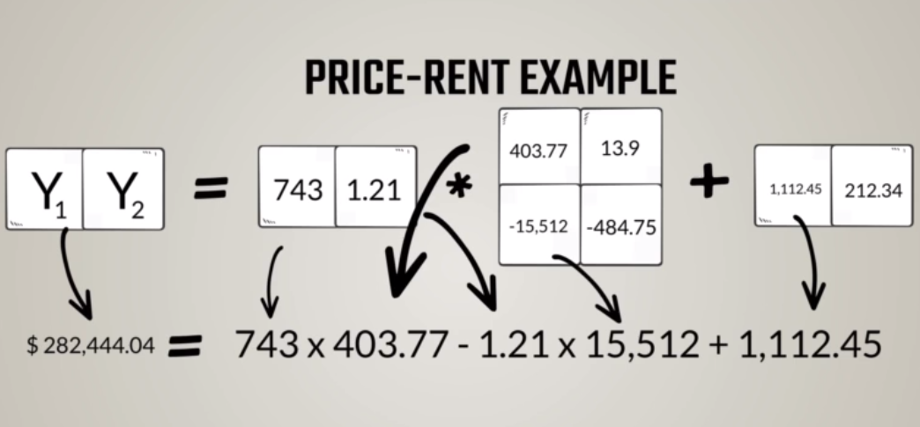
Multiple Output

Slide 8
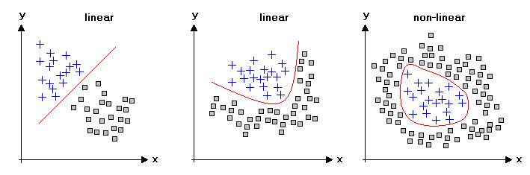
NON LINEAR MODEL

Slide 9
OBJECTIVE FUNCTION
LOSS FUNCTION
LOWER THE LEVEL HIGHER THE ACCURACY
ERROR FUNCTION
SUPERVISED MODEL
REWARD FUNCTION
HIGHER THE LEVEL HIGHER THE ACCURACY
REINFORCEMENT MODEL

Slide 10
LOSS FUNCTION
SUPERVISED LEARNING
REGRESSION
L2-NORM
CLASSIFICATION
CROSS ENTROPY
OUTPUT SHOULD BE CLOSE TO THE TARGET

Slide 11
LOSS FUNCTION
REGRESSION
Continuous values
Squared loss ( L2-norm)
Sum of the Euclidean distance of outputs to targets
Have to low

Slide 12
L2-norm
L2-norm =Σ (y_{i}-t_{i})²
^{Norm is the vector norm}
Euclidean distance of the output and targets
The lower the value lower the error

Slide 13
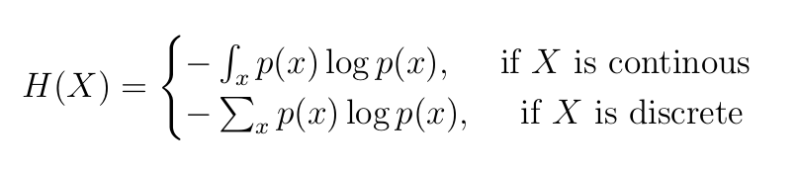
CROSS ENTROPY MEASURE
Entropy of a random variable X is the level of uncertainty inherent in the variables possible outcome.
For p(x) — probability distribution and a random variable X, entropy is defined as follows

Slide 14
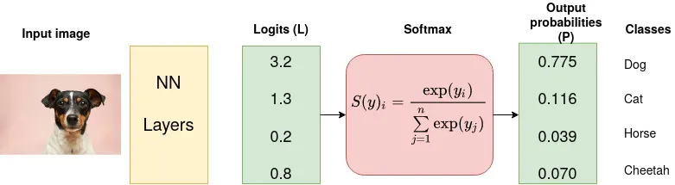

Slide 15
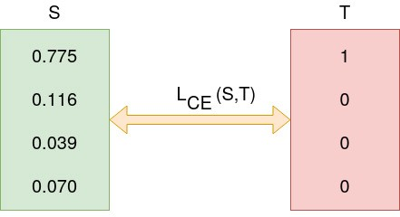
CLASSIFICATION – CROSS ENTROPY

Slide 16
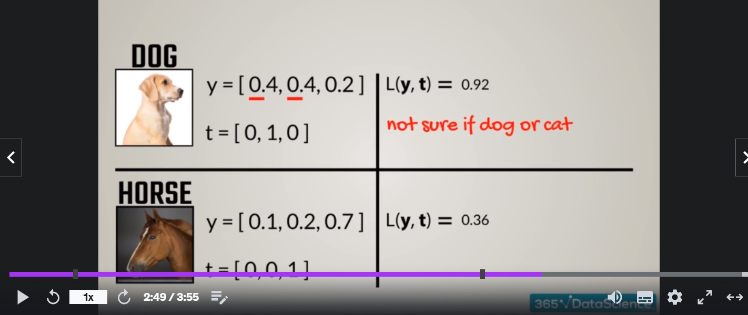
LOSS FUNCTION

Slide 17
OPTIMIZATION ALGORITHM
GRADIENT DESCENT ALGORITHM
Works on derivative
Eg f(x) =5x² ⁺3x-4
Goal : Find the minimal
f’(x) = 10x + 3

Slide 18
Gradient Descent Algorithm
Gradient descent is —
→ an iterative optimization algorithm
→ for finding the local minimum of a function
→ by taking smaller steps
→ proportional to the negative of the gradient (opposite direction of the gradient) of the function at the current point.

Slide 19
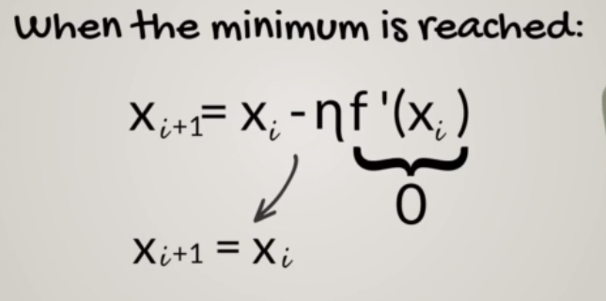

Slide 20
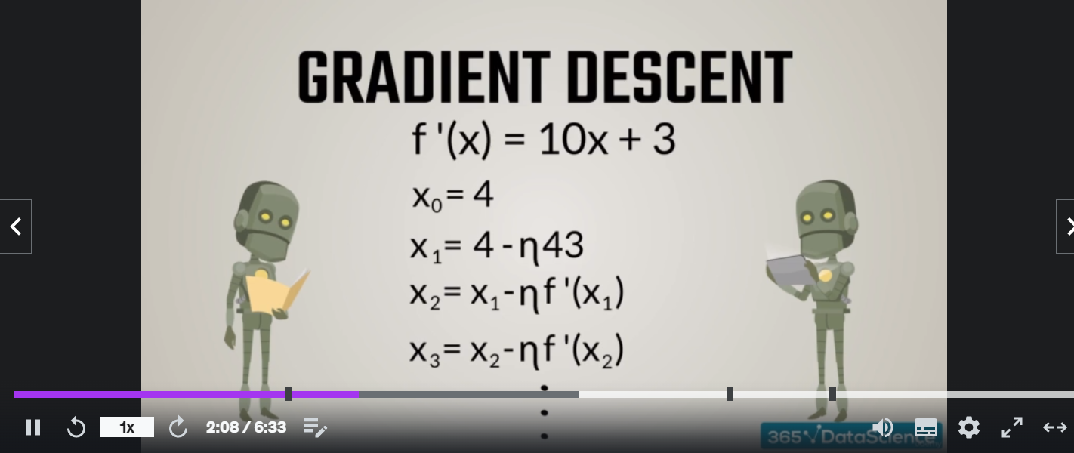
GRADIENT DESCENT

Slide 21
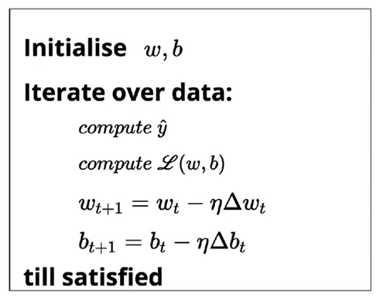
ALGORITHM

Slide 22
